Slide 1


IKC & Four-Stage Clustering Pipeline
Presenter: Bartosz Bryg

Slide 2
Graph specification – center-periphery structure
Graphs tend to have:
Many strongly connected smaller communities (at higher granularity)
Fewer strongly connected larger communities (at lower granularity)
These communities contain:
Core - very strongly (densely) connected components – each vertex has a high degree (k connected vertices)
Periphery - Additional vertices surrounding the core which are less strongly connected (p connected vertices while p < k)
Markers – Vertices that are the most important (most valuable) for the graph

Slide 3
Problem Statement
In what different ways can we detect communities containing center-periphery structure from the citation network depending on what we want to learn about a graph?
Algorithm can return:
Large or small more refined clusters
Many or less peripheral vertices belonging to clusters
Clusters only with the most relevant vertices
Higher or smaller node coverage (the number of vertices and edges returned)
(By increasing k value or/and increasing modularity, node coverage is significantly smaller)

Slide 4
Hypothesis
Citation network contain center-periphery communities.
Dense, strongly connected publications are central – most relevant – CORE
Loosely connected publication are less important, fringe - PERIPHERY

Slide 5
Using IKC algorithm for the citation network or other networks
Ensuring that returned clusters are kmp-valid:
k-valid – each core node in cluster has at least k other core nodes
m-valid – formed clusters are communities – their modularity is positive
p-valid – each augmented peripheral node is connected to p or more core nodes

Slide 6
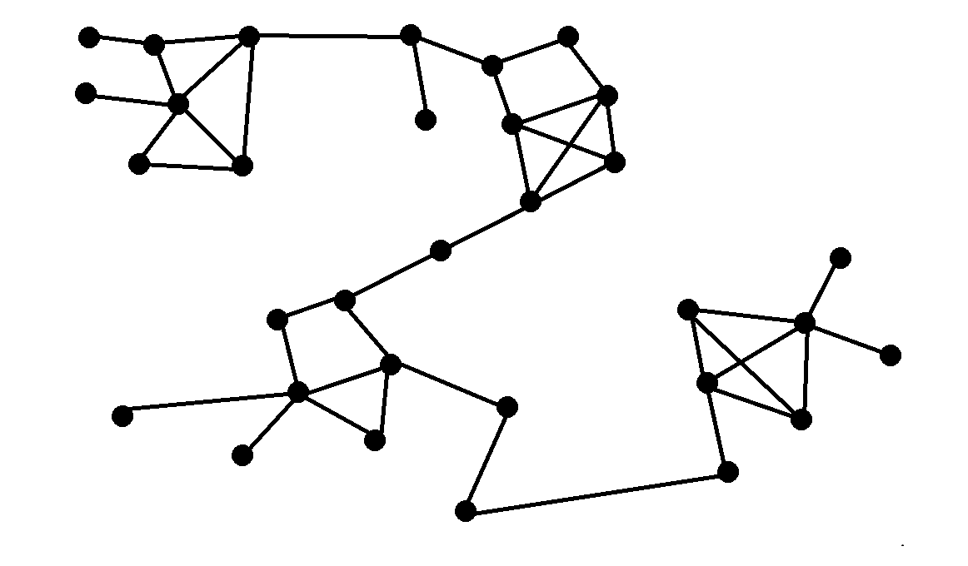
IKC without Graclus
Initial Graph

Slide 7
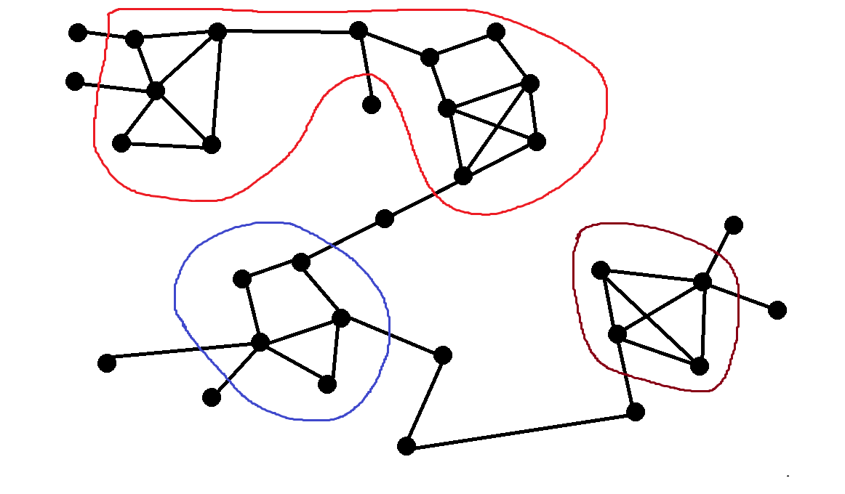
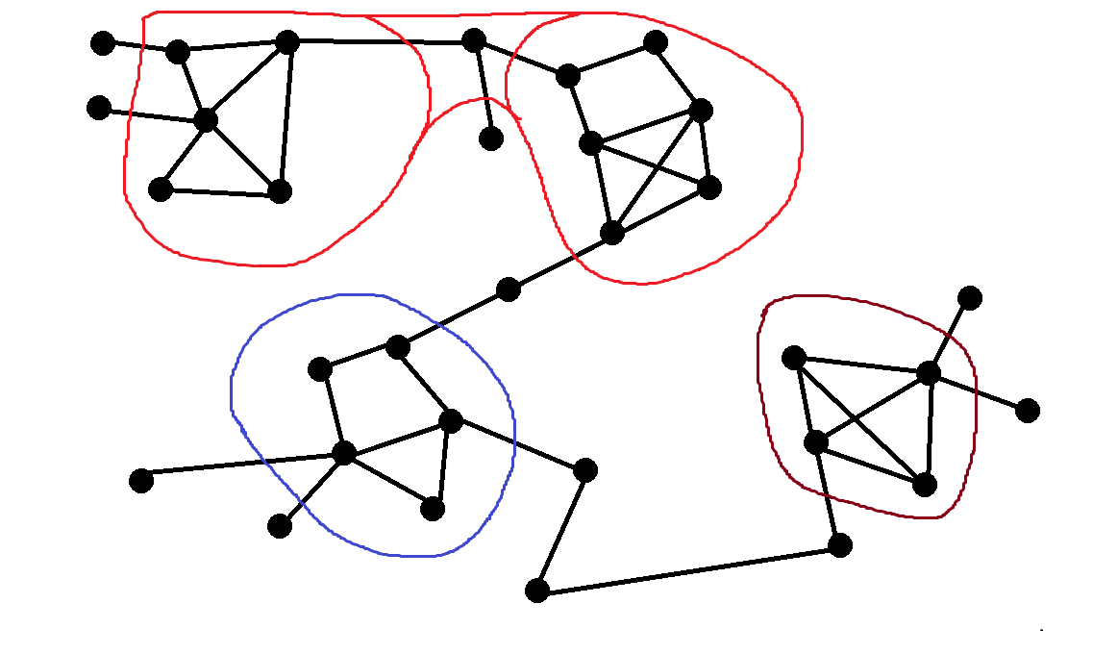



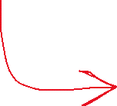

IKC without Graclus
After k-core clustering
K = 3

Slide 8
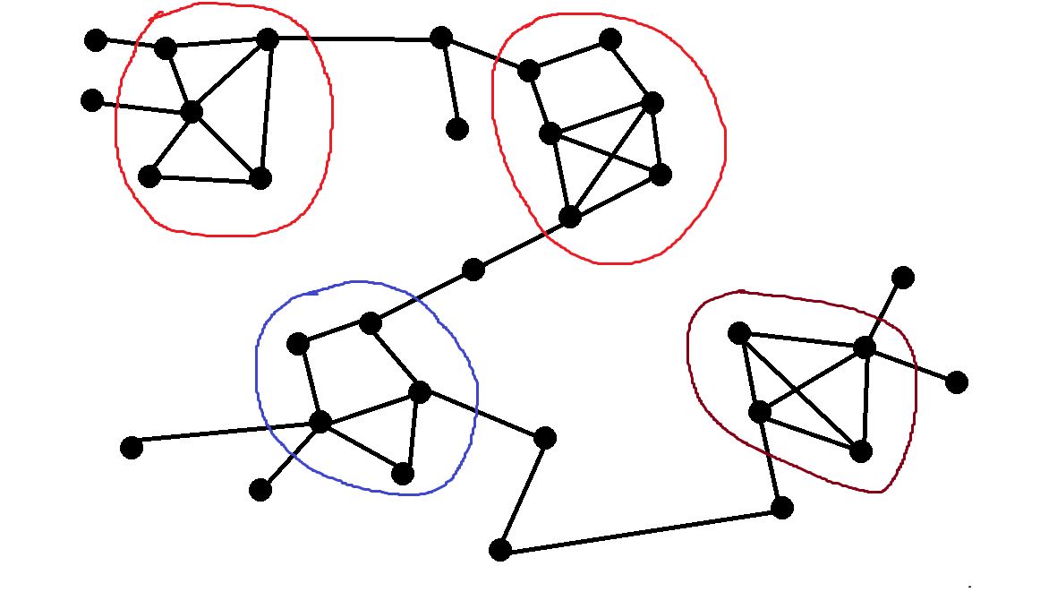



IKC without Graclus
After modularity check – to assure m-validity

Slide 9
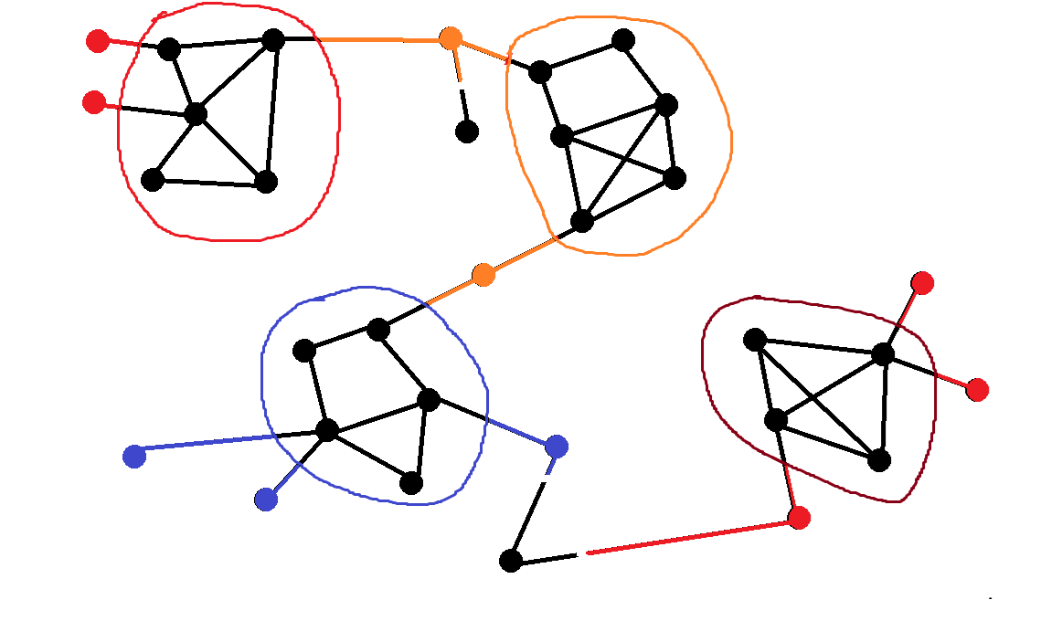



IKC without Graclus
After augmentation – ensuring p-validity
P = 1

Slide 10
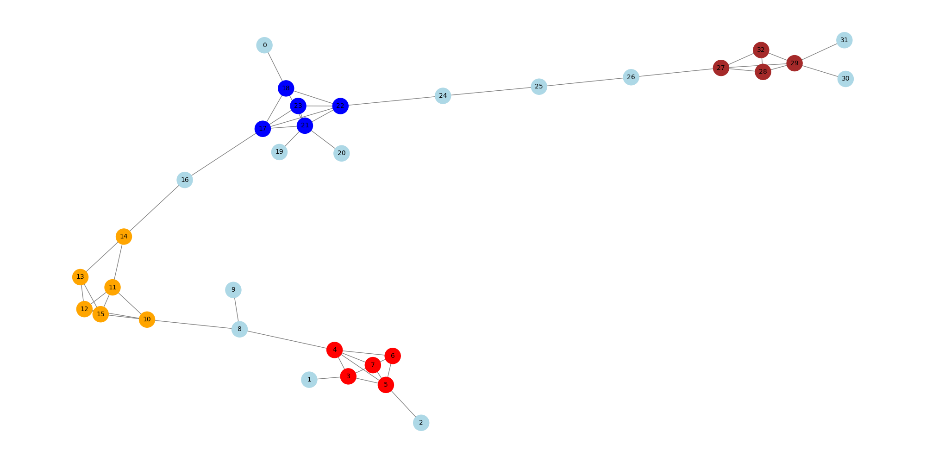
Initial graph

Slide 11
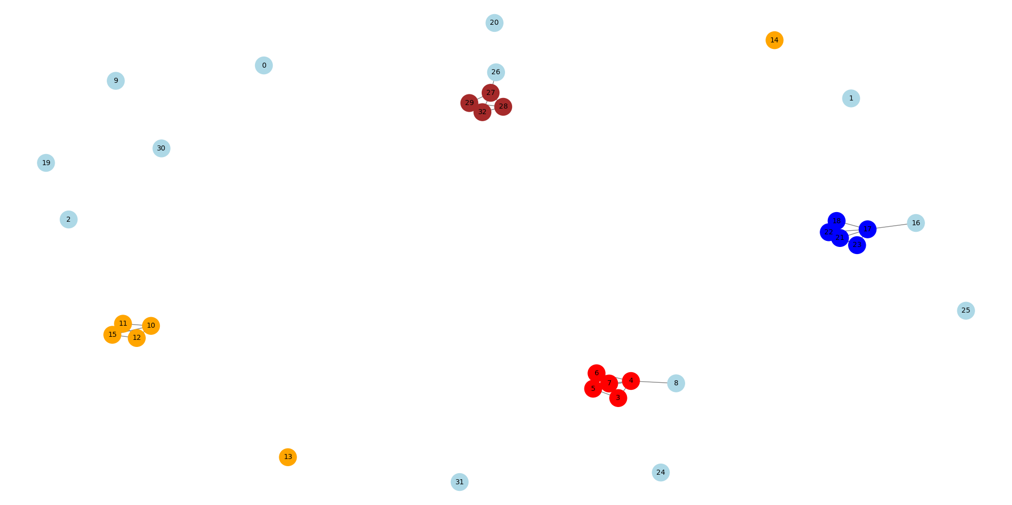
After first while loop

Slide 12
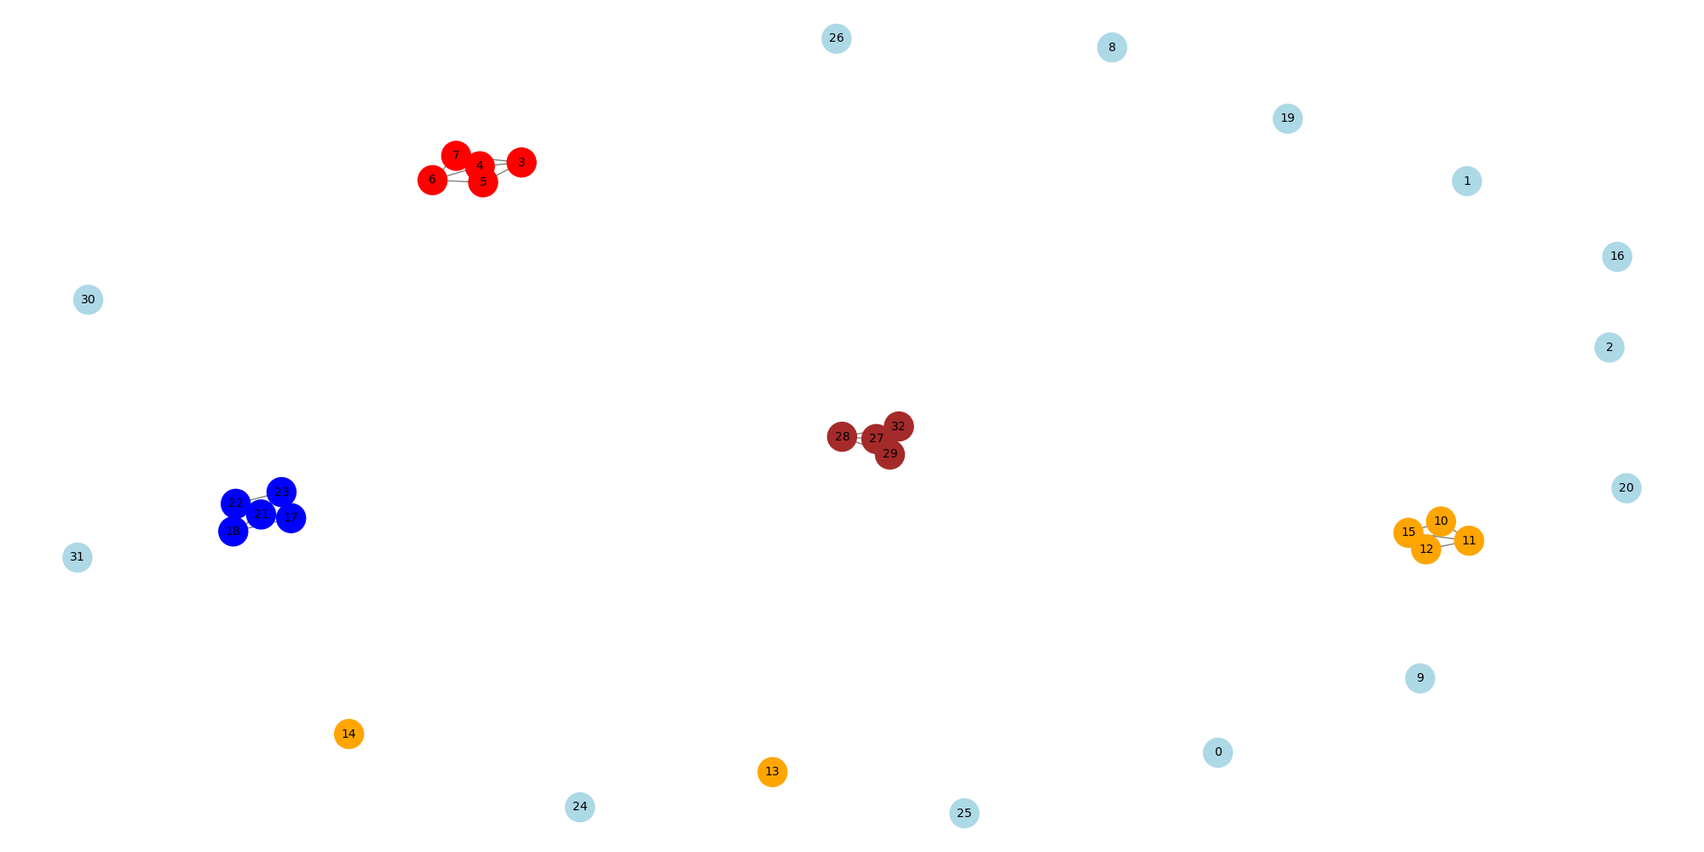
Final Graph

Slide 13

Pseudocode of IKC (with four-stage clustering)
Let SRC be an array with source nodes, DST with destination nodes. SRC and DST are Sorted!
Let k be an integer equal to 3, p is an integer equal to 1, L is an integer with the largest node degree
Initialize Bin B (e.g. dictionaries) containing key-value pairs equal to: “core”–list of core nodes and “periphery”-list of peripheral nodes
K-core clustering (Label all nodes with their corresponding degrees and run k-core check)
Extract all nodes to a single array called Nodes and Create dictionaries called Degrees and Adjacency List
------------------------------------------------------------------------------------------------------------------------------------------------
FOR i equals to 0 to length of SRC Array minus 1
source variable equals SRC[i] and destination variable equals DST[i]
Degrees[source] increase by one and Degrees[destination] increase by 1
Add destination to Adjacency List[source] and source to Adjacency List[destination]
IF source or destination variable are greater than L THEN
L is equal to the current source or destination degree (the one larger)
ENDIF
ENDFOR
O(E)
E = Number of edges in the Graph

Slide 14
Pseudocode of IKC (with four-stage clustering)
Removing Nodes to ensure k-validity
Initialize Queue and Periphery Array
IF L < k THEN
RETURN Empty Bin B and exit the program
ELSE
FOR each key (labeled node) in Degrees Array
IF Degrees[labeled node] is less than k THEN
Remove this node from Nodes array and append it to Queue and Periphery Array
ENDIF
ENDFOR
O(N)
N = number of nodes in the Graph

Slide 15
Pseudocode of IKC (with four-stage clustering)
Removing Nodes iteratively to ensure k-validity in core-core nodes relation
WHILE Queue is not empty
Current node equals Popped first element from Queue
FOR each neighbor in Adjacency List[current node]
Degrees[neighbor] decrease by 1
IF Degrees[neighbor] equals k-1
Remove neighbor from Nodes array and append it to Queue and Periphery Array
ENDFOR
Degrees[current node] is equal -1 to mark it as inactive node (so that it’s never equals k-1)
ENDWHILE
O(Q + E)
Q = number of nodes in the Queue

Slide 16
Pseudocode of IKC (with four-stage clustering)
Forming multiple clusters k and m valid clusters - Performing BFS
Initialize Visited Array
FOR each node in Nodes array
IF node not in Visited Array
Create a Stack and append current node, also create empty Cluster Array
WHILE Stack is not empty
Current node equals Popped first element from Stack
IF current node not in Visited Array
Add current node to Visited Array
Append current node to Cluster Array
[…]
O(N + E)

Slide 17


Pseudocode of IKC (with four-stage clustering)
Creating clusters to ensure m-validity (Finishing stage of IKC)
[…] FOR neighbor in Adjacency List[current node]
IF neighbor not in Visited Array and neighbor not in Periphery Array
Append neighbor to Stack
ENDIF
ENDFOR
ENDWHILE
IF Cluster Array is not empty and has a positive modularity using formula $mod\left(Cluster\right)= \frac{ls}{L}−{\left(\frac{ds}{2L}\right)}^{2}$
Append Cluster Array to Bin B under “core” key
ENDIF
O(N + E)
Overall IKC Time Complexity: O(N + E)

Slide 18

Pseudocode of IKC (with four-stage clustering)
Graclus (split clusters into smaller subclusters)
OPTIONAL
O(C x (N + E))
C = number of clusters in the graph
FOR each cluster in “core” from Bin B
Temporary 2 “Subcluster” arrays with possible nodes from cluster (Min Cut to spilt main cluster)
FOR each Subcluster
Append Subcluster array to Bin B under “core” key
(We can also check if two Subclusters have a positive modularity using formula $mod\left(s\right)= \frac{ls}{L}−{\left(\frac{ds}{2L}\right)}^{2}$, however, the check is performed in kmp parsing Stage)
Remove the cluster from Bin B under “core” key
ENDFOR
ENDFOR

Slide 19
Pseudocode of IKC (with four-stage clustering)
Augmentation
FOR each cluster in “core” from Bin B
Temporary dictionary Per with keys equal to nodes and values equal to p-connections
FOR i equals to 0 to length of SRC Array minus 1
IF SRC[i] in Periphery Array and DST[i] in cluster THEN
Per[SRC[i]] is increased by 1
IF DST[i] in Periphery Array and SRC[i] in cluster THEN
Per[DST[i]] is increased by 1
Initialize Array called “Temporary”
FOR each key=node in Per dictionary
IF value of a node is equal or greater than p THEN
Append key (node) to array “Temporary”
Append “Temporary” array to Bin B under “Periphery” key
ENDFOR
O(C x (E + N))

Slide 20
Pseudocode of IKC (with four-stage clustering)
Kmp-parsing – Optional but mandatory when using Graclus
O(C x (E + N)) or
O(N^3)
(if run with MDS)
Assuring that each Cluster is kmp-valid
a. For each node in cluster in Bin B under “core” key along with the nodes from “periphery” key assigned to the same index as cluster:
1. Re-label nodes using the k-core labeling algorithm (can be from previous slides)
2. Identify core nodes (those with degree ≥ k) and non-core nodes (those with degree < k)
3. Ensure that all core node subclusters have positive modularity
4. Ensure all periphery nodes have at least p connections to core nodes
5. If the cluster is not kmp-valid, discard or modify it
b. Store the final kmp-valid clusters in a set C_final
c. (OPTIONAL) Run MDS (Multidimensional Scaling) to see which clusters are the most important

Slide 21
Big-O Notation
IKC: O(N + E)
Graclus: O(N + E) for each cluster – O(C(N + E)) in total
Augmentation: O(N + E) for each cluster - O(C(N + E)) in total
Kmp-Parsing: O(N + E) for each cluster - O(C(N + E)) in total
or O(N^3) if MDS included
N – Number of Nodes/Vertices in the Graph
E – Number of Edges in the graph
C – Number of Clusters in the Graph

